Slide 1


Battery powered Smart Table Fan and Lamp
DEPARTMENT OF ELECTRONICS AND COMMUNICATION ENGINEERING MOTILAL NEHRU NATIONAL INSTITUTE OF TECHNOLOGY ALLAHABAD, PRAYAGRAJ, UTTAR PRADESH, 211004, INDIA

Slide 2
Team members
Aditya Sharma
Gaurav Kumar
Vivek Rai
.

Slide 3
Index
Introduction
Approach
Flowchart
Atmega32A
LM35 temperature sensor
LDR(Light dependent sensor)
4. Budget

Slide 4
Introduction
This smart table fan and light works on manual mode or on auto mode without any human interruption.
The fan speed and light intensity in manual mode are controlled using potentiometers.
The user can also switch to auto mode in which he doesn’t need to worry about fan intensity and light speed as these adjust according to temperature and light intensity of the surrounding.
LM 35 sensor is used to measure temperature and LDR is used to measure light intensity and this data is displayed on a 16X2 LCD display.

Slide 5
Approach
In this project, we have made a smart fan and light using atmega32A microcontroller. Atmega32A has been used to obtain values of physical conditions(temperature and light intensity) through LM35 and LDR connected to it.
The obtained values have been used to change fan and light intensity which are driven using motor driver L293D. PWM input is given to the motor driver.
The battery backup has been provided with the help of two 4000mAh batteries connected in series.

Slide 6
Flowchart
START
AUTO MODE FOR FAN/LIGHT
POTENTIOMETER OF FAN/LIGHT MUST BE AT 0
MANUAL MODE FOR FAN/LIGHT
AUTO MODE FOR FAN TAKES VALUE FROM LM35 SENSOR AND CHANGES FAN SPEED ACCORDINGLY
AUTO MODE FOR LIGHT TAKES VALUE FROM LDR AND CHANGES LIGHT INTENSITY ACCORDINGLY
FAN SPEED / LIGHT INTENSITY CONTROLLED USING POTENTIOMETER

Slide 7
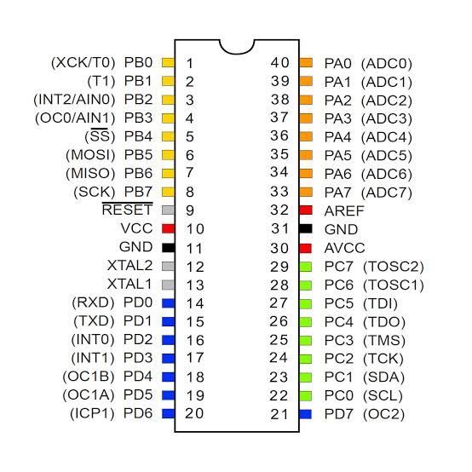
ATMEGA32A
ATMEGA32A is a 32-bit microcontroller.
It has 32KB ISP flash memory with read-while-write capabilities.
It has 4 PWM channels.
The microcontroller works at a default clock frequency of 1MHz.
32K bytes of in system self programmable flash program memory.
It has 10 bit ADC.

Slide 8
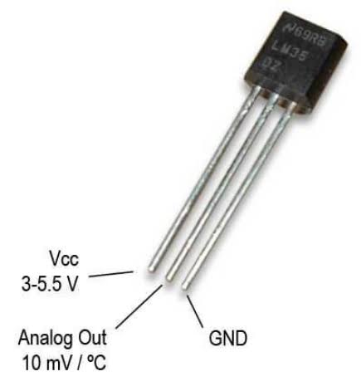
LM35 temperature sensor
LM35 is a temperature sensor, whose output voltage is linearly proportional to the Celsius (Centigrade) temperature.
The LM35 does not require any external calibration or trimming to provide typical accuracies.
it is a linear sensor i.e. 10mv/°C which means for every degree rise in temperature the output of LM35 will rise by 10mv.

Slide 9
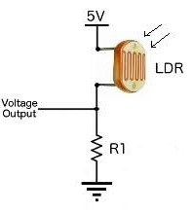
LDR(Light dependent sensor)
A light dependent resistor (LDR) or a photo resistor or photocell is a light controlled variable resistor. Its resistance changes with Light intensity that falls on it.
It works on the principle of photoconductivity.
The resistor of a LDR decreases with increasing incident light intensity.

Slide 10
BUDGET
Component | Price
Development Board (including Atmega32A, switches, capacitors, etc) | 400
Fan | 140
Light | 50
Battery | 180
Frame | 50
Motor Driver L293D | 120
TP4056 Battery Charger Module | 60
XL6009 Boost Buck Converter | 110
LCD display | 130
Switch and potentiometer | 80
LM35 sensor and LDR | 80
Total cost | 1400

